Slide 1
Pulse PT
Rafael Montes
Parth Desai
Sam Bohr
Andrew Alhaj
Daniel Christenson
Julian Ajja

Slide 2
Risks and Challenges
Coming up with intuitive UI designs
Learning Mongodb
Trying to get the downloadurl
Nothing much
Implementation
of Redux
Rafael
Sam
Andrew
Daniel
Julian

Slide 3
User Stories UI
As a trainee I would like a simple and fast way to view trainers ready to take me on.
As a trainee I would like a simple way to navigate the search menu so that I can easily view how to do exercises.
Project final documentation has been started.

Slide 4
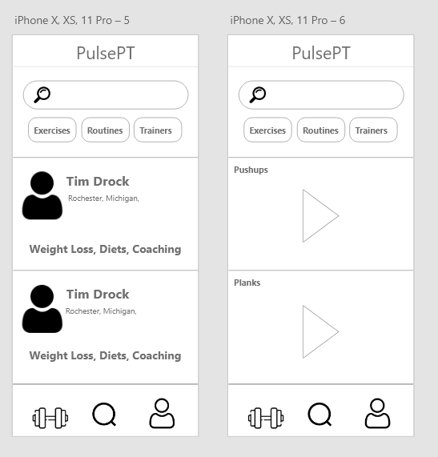
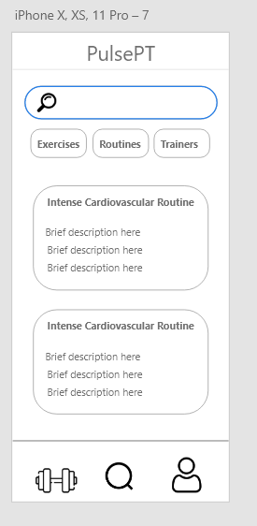
Conceptual UI Design

Slide 5
Client Details
As a trainer, I would like to be able to select a client to view their profile in depth by selecting them from my list of clients.
Researching Redux
Utilized Redux and React Router for implementation

Slide 6
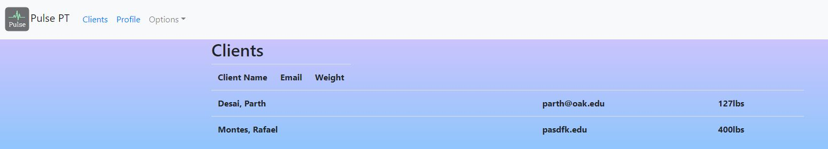
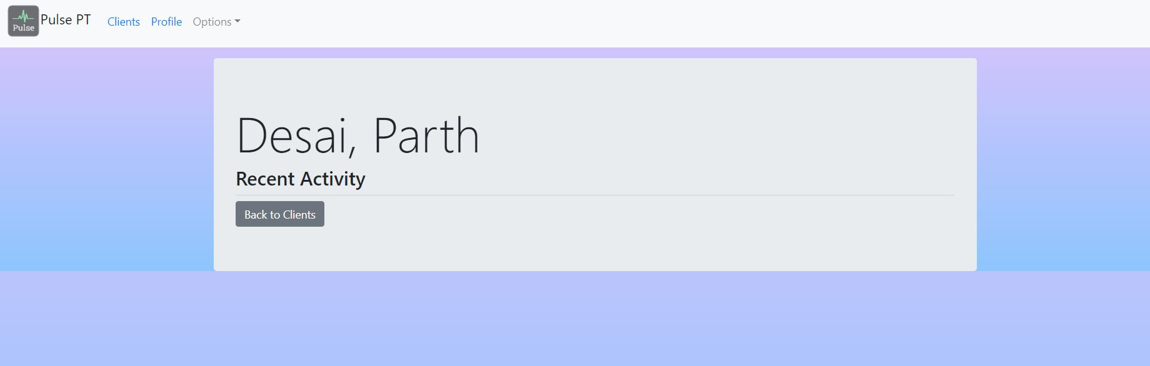
Subscriber Detail Page

Slide 7
Next Sprint Objectives
As a trainer, I would like to see all the essential details of my client on their details page .
As a trainer, I would like cleaner looking pages that are easier to use and navigate.

Slide 8
Mobile Profile Picture
As a subscriber, I want to upload a Picture for my Profile page.

Slide 9
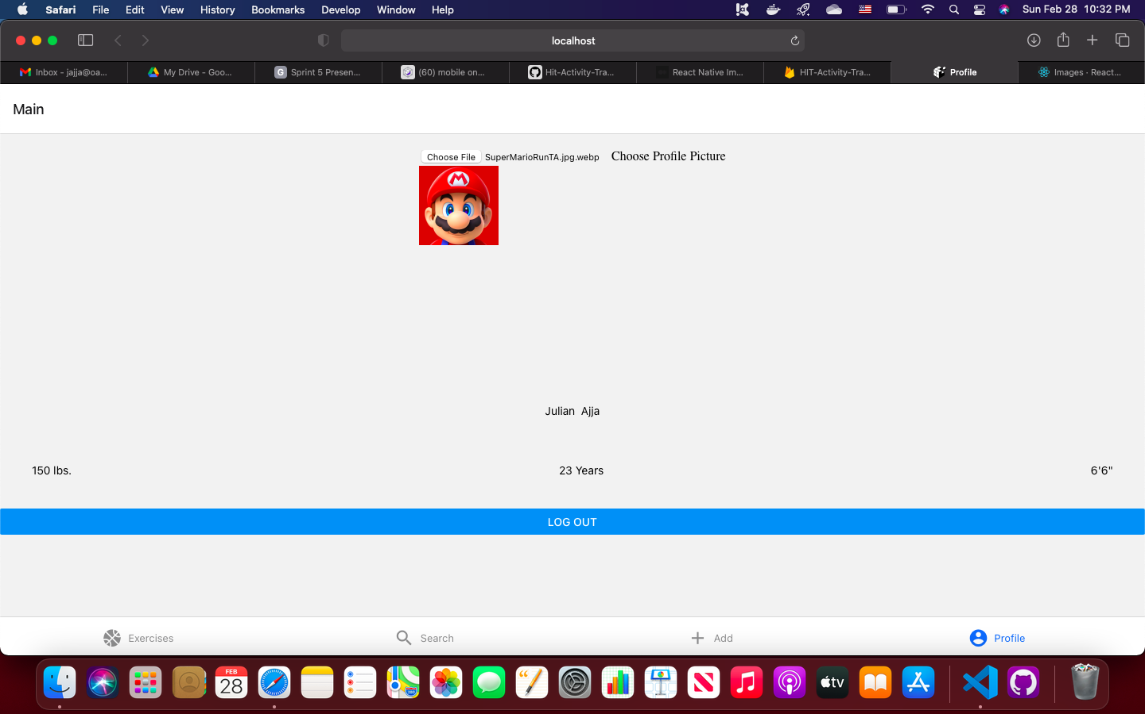
Mobile Profile Picture

Slide 10
User Stories for next Sprint
As a subscriber I would like to see my routines that have been assigned in my Exercise page.

Slide 11


Profile Picture
User Story: As a trainer, I would like to be able to upload and view a profile picture on my profile
Research
Put download url in database
Display image using firebase and react
Display on profile page using react props
Test

Slide 12
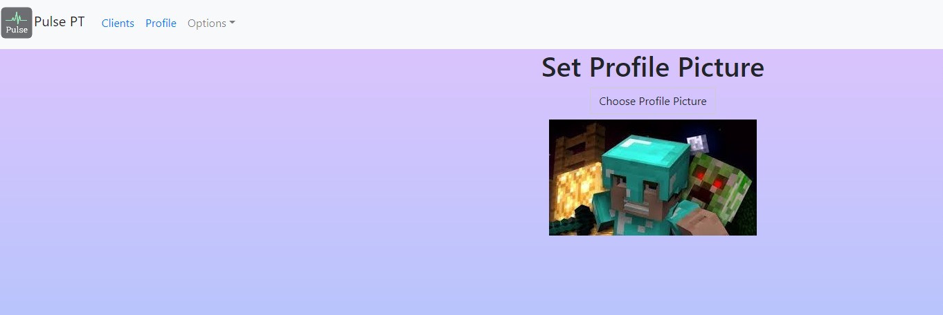
Profile Picture

Slide 13
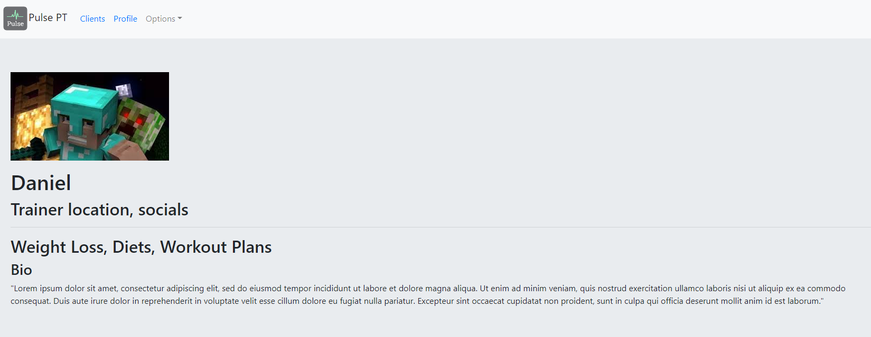
Profile Picture

Slide 14
Next Objectives
Finish Edit Profile Page
Display all user info on Profile Page
Add picture to workout page

Slide 15
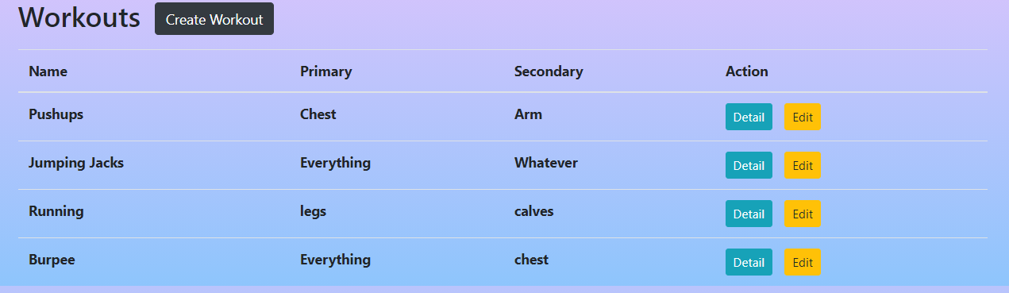
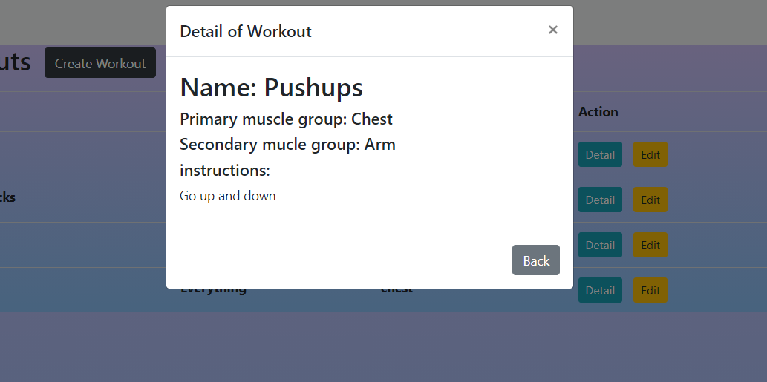
Workout page
User Story: As a trainer, I would like to be able to view the available workouts.
As a trainer I would like to view detailed information of a workout
Workouts displayed in a table
Can view detailed information of a workout.

Slide 16
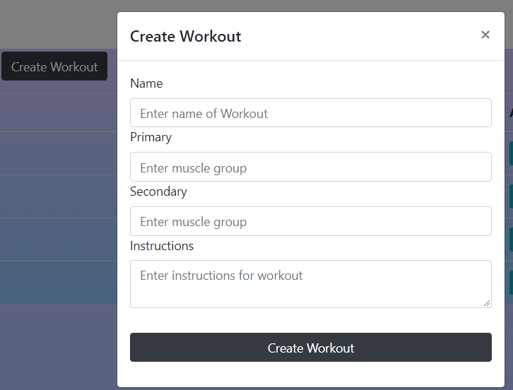
Workout page
User Story: As a trainer, I would like the ability to create a workout.
Created a form to create workout.
When submitted, updates the UI and the database.

Slide 17
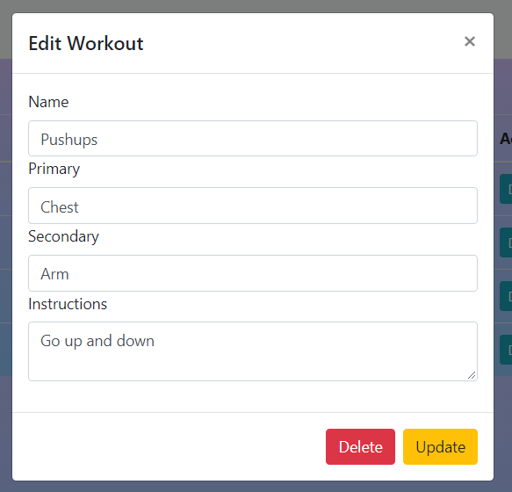
Workout page
User Story: As a trainer, I would like to edit the workouts.
As a trainer, I would like to be able to delete workouts.
Created a form that allows to make edits of a particular workout.
Button to delete workout.

Slide 18
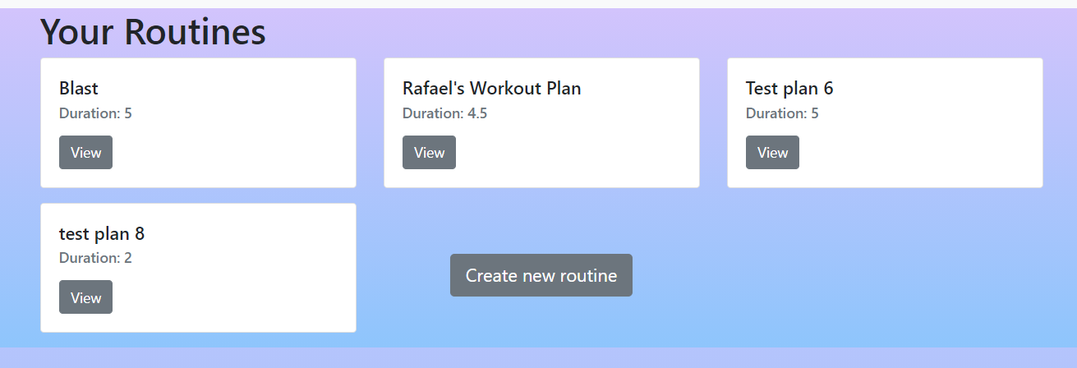
Routine Page
User Story: As a trainer, I would like to be able to see a list of my routines that i created.
As a trainer, I would like to see the details of a routine.
As a trainer, I would like the ability to delete a routine.
Routines page displays all the routines that the trainer created.
When you hit view you are taken to the details page where you can also delete routine

Slide 19
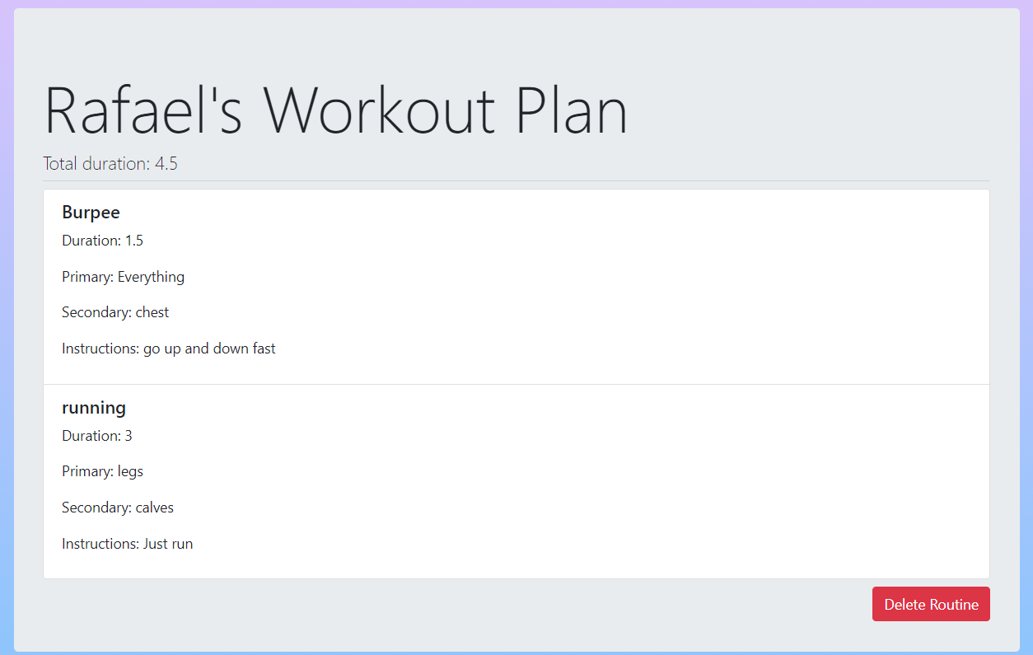
Routine Page

Slide 20
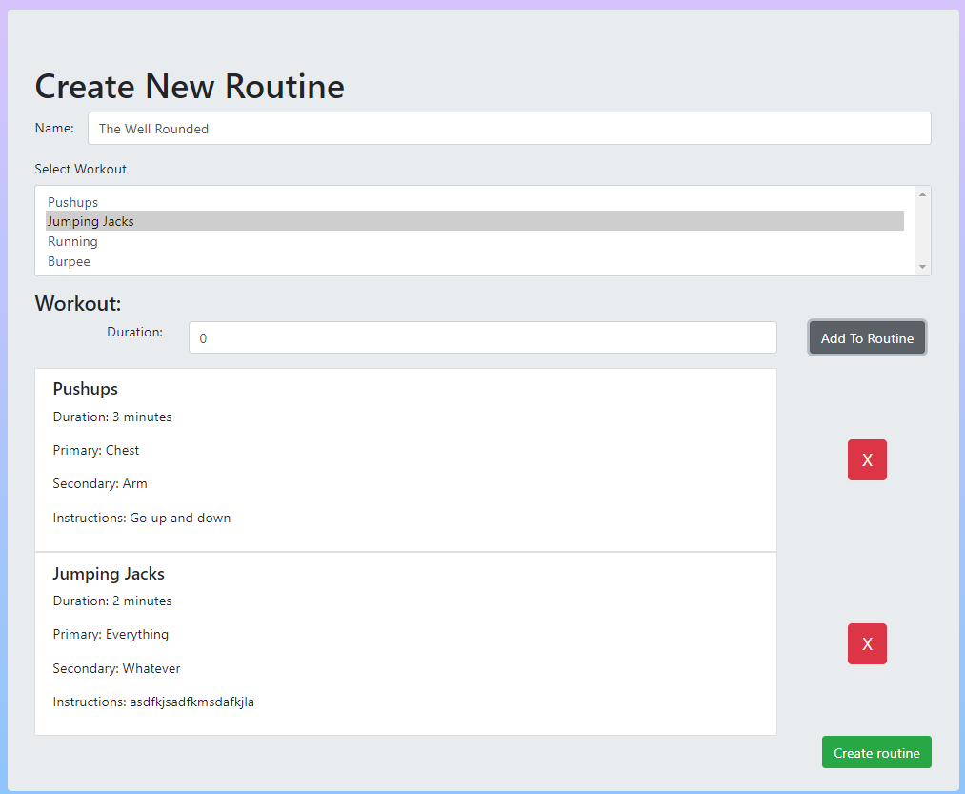
Routine Page
User Story: As a trainer, I would like to be able to create my own routines.
Pull list of workouts to create the routine.
Name the routine
Set the duration of a workout
Has validation

Slide 21
Next Objectives
Create programs for clients.
Implement logic for user to start working out
Implement heart rate logic (maybe this sprint or following one)

Slide 22
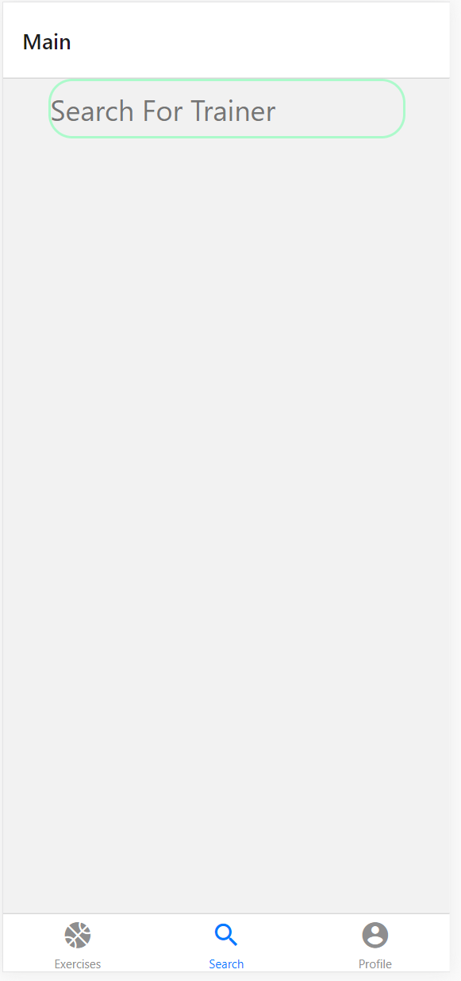
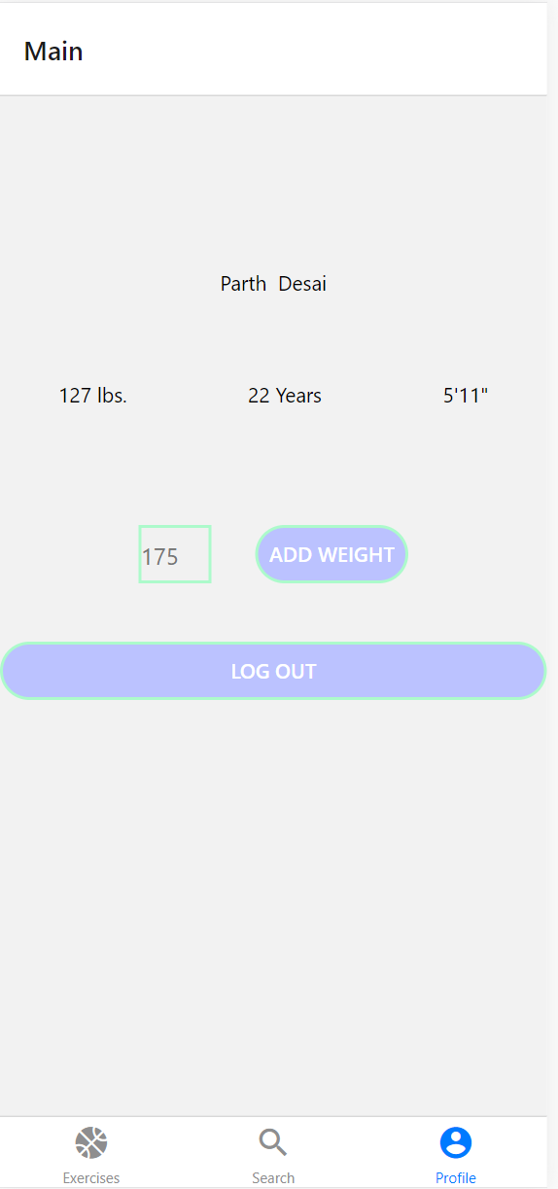
Mobile This Sprint
Subscriber
I would like a button on the weight attribute of my profile page to update my weight as I progress
I would like to be able to search for trainers with a filtered search

Slide 23
Mobile Next Sprint
Subscriber
I would like a page to display trainer Info with bio and Picture so I can learn about possible trainers
I would like a button to subscribe to a trainer on the Trainer Profile Page so I can start getting routines
I would like to see my past weights displayed on my profile in a graph to my progress over time

Slide 24
Demo

Slide 25
THANKS

